Slide 1


Students:
1.Mamoun Faisel Alkorom .
2. Course name : FullStack PHP WebDevelopment .
Coh_9
2022/2023

Slide 2
Outline
Introduction
POS
Problem Statement
Design Models
Demo

Slide 3
Introduction
Because programming is a way to help us develop the quality of life for the world, So we have created a program that includes a point of sale system to provide the necessary needs

Slide 4
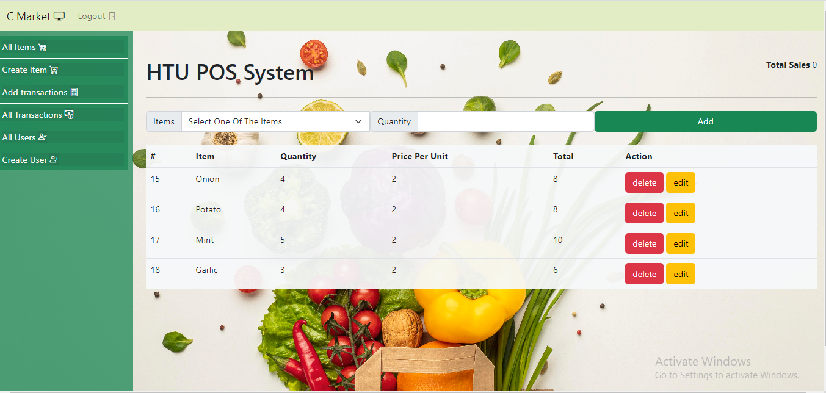
POS
1. POS website :
POS system calculates the price of an item, including any sales tax, and then updates your inventory count to show that the item has sold. However, advanced POS systems go well beyond this to serve as the central hub of a business that handles many essential tasks: sales, inventory and customer management, reporting, price adjustments and so much more. .

Slide 5

Problem Statement
Due to the ineffectiveness of the manual system in counting sales, to reduce the error rate, and to avoid problems in counting the quantities available in the store, the manual system was dispensed with and replaced with modern electronic systems.

Slide 6
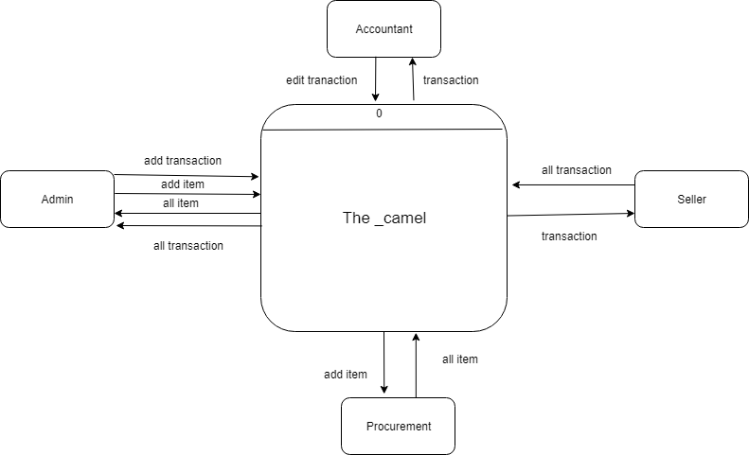
Design Model
Context Diagram

Slide 7
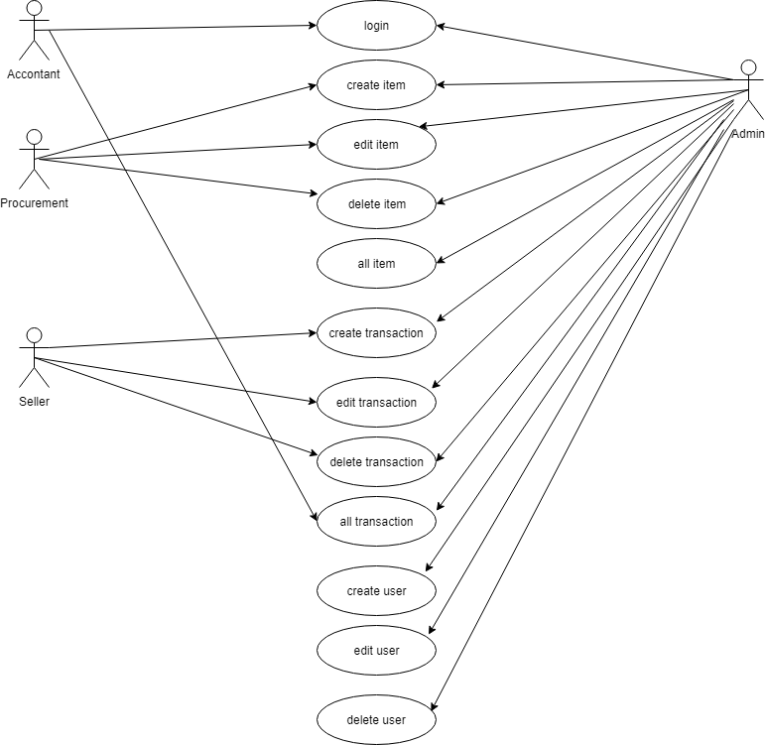
Design Model
Use Case Diagram

Slide 8
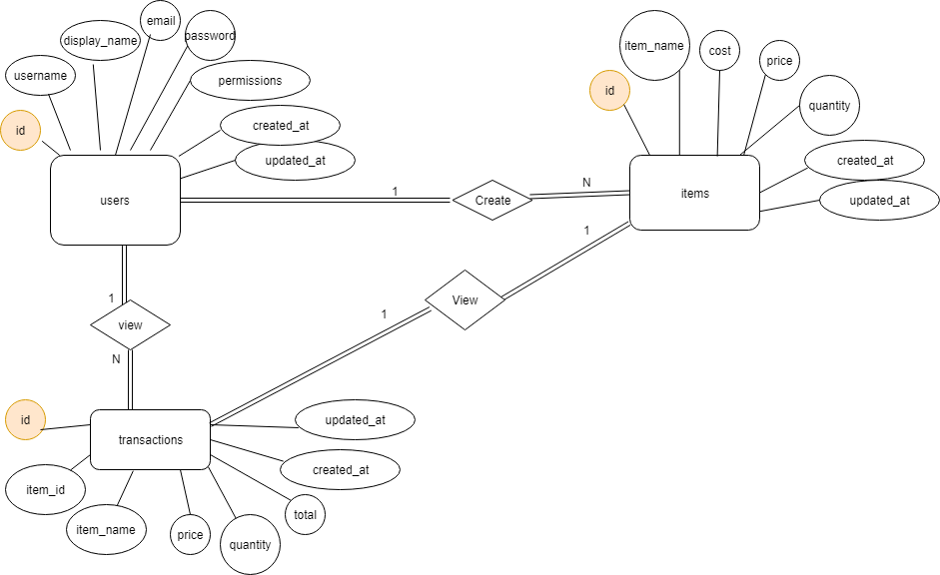
Design Model
ER Diagram

Slide 9
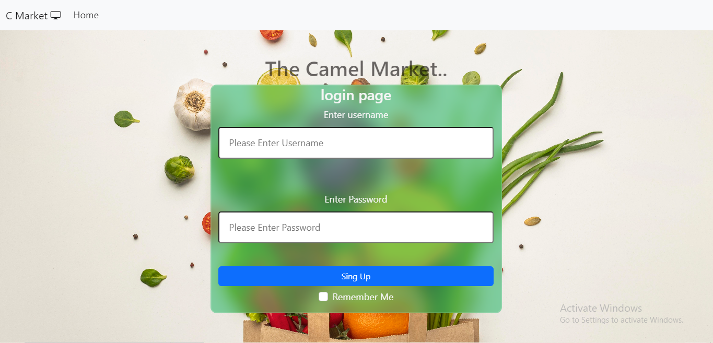
The POS

Slide 10
Thank you very much for your time.
Thanks to HTU

